Slide 1

Project Presentation Week 2
Lilian Mirabel – Florian Chapoullie-Pino
Luc Lacotte – Floris Rimbeau
1

Slide 2
Links between collections via SKU
Week 2 Objective
The main objective of this sprint is to integrate AI-driven automation into the retail inventory management system.
Enable the AI agent to analyze sales and stock data to identify at-risk SKUs.
Automatically generate purchase orders through the backend MCP layer.
Deliver a functional dashboard that provides visibility into stock levels, purchase orders and key performance metrics.
Notes:
floris

Slide 3

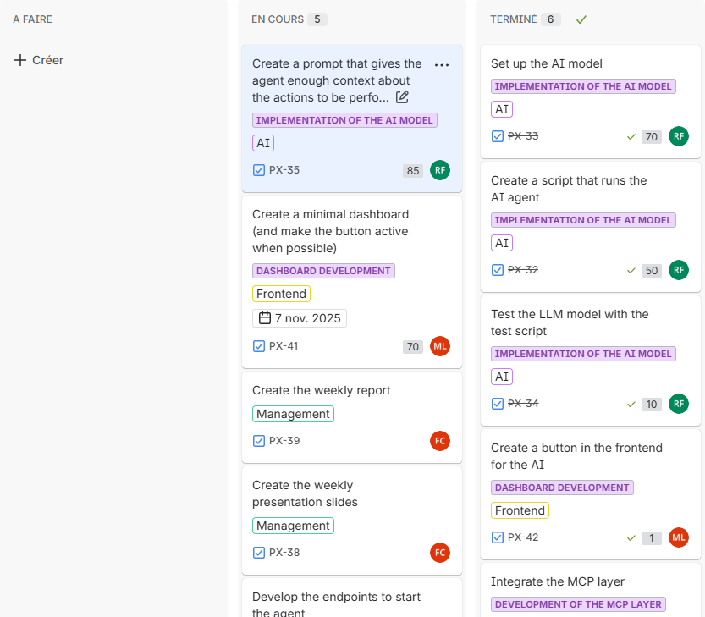
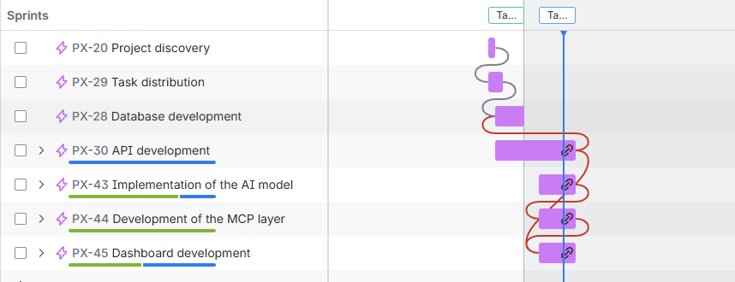
Organisation
We have organised ourselves with Jira for the distribution of work.
3
Notes:
Luc

Slide 4
Distribution of tasks
Luc : API development, MCP layer
Floris : AI Agent implementation
Florian : Project management & front-end development
Lilian : Front-end development
Notes:
luc

Slide 5

Minimalist Dashboard
5
Notes:
lilian

Slide 6
AI Agent
6
Notes:
lilian

Slide 7
MCP Layer
Notes:
floris

Slide 8
Backend endpoints
8
Notes:
lilian

Slide 9
Next steps for Week 3
Key Tasks
Fine-tune agent logic & adaptive decisions
Run simulations & monitor KPIs
Deliverables
Functional autonomous agent
Simulation result
Notes:
florian

Slide 10
Conclusion
The project aims to make strategic decisions to improve productivity.
The project aims to make strategic decisions to improve productivity.
The project aims to make strategic decisions to improve productivity.
The project aims to make strategic decisions to improve productivity.
This sprint helped us strengthen our system and advance the AI agent.
We learned AI automation, backend integration, dashboard development, and API orchestration.
We are now ready for simulations, evaluation, and the final presentation.
Thank you for listening.
10
Notes:
lilian

